Slide 1
بسم الله الرحمن الرحیم
Notes:
Introduce yourself
ان شاء الله که وخت خوب و پربرکت خواهیم داشت

Slide 2
JS101 Introduction to Programming with Javascript

Slide 3
0 1
Notes:
Computer only understands zeros and ones

Slide 4
JS Engine
Source Code →
→ machine Code
Notes:
- JavaScript Engine converts Source code to machine readable code

Slide 5


Notes:
In web, a client requests a page from the server.
We can run algorithms on client-side, which has the following benefits:
Less load on server
More interactive
(think about other benefits yourself)

Slide 6
algorithm
Notes:
Algorithm is step-by-step instruction to so something
Algorithm can be correct, incorrect, efficient or inefficient.

Slide 7
1 Pick up dictionary
2 Open to middle of dictionary
3 Look at page
4 If word is on page
5 Read the Definition
6 Else if word is earlier in dictionary
7 Open to middle of left half of dictionary
8 Go back to line 3
9 Else if word is later in dictionary
10 Open to middle of right half of dictionary
11 Go back to line 3
12 Else
13 Quit
Notes:
Pseudocode is the representation of algorithm in a human language (Farsi, Pashto, English).
We can implement an algorithm in javascript

Slide 8
Variable
Stores a Value
Notes:
Variable is a container that stores a value

Slide 9


Slide 10
Primitive types
Object Type
Numbers
Strings
Booleans
Undefined
null
Object
Array
Function
Notes:
Primitive types are immutable
Even function and array are objects

Slide 11
Function
Perform an Action

Slide 12

Notes:
Function can be treated as a value in javascript

Slide 13
Conditionals
Make Decision

Slide 14
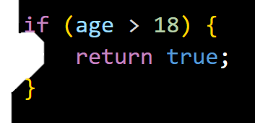

Slide 15
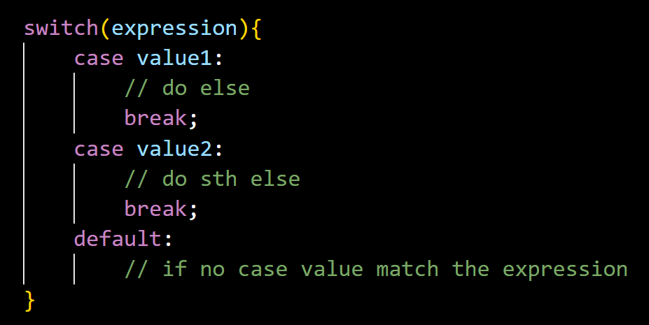

Slide 16
Loops
Do Something Again and Again

Slide 17
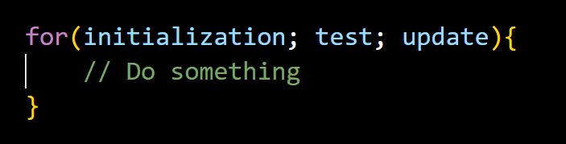

Slide 18
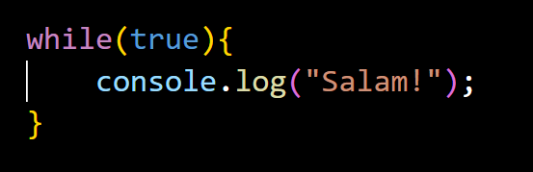
Notes:
- Infinite loop

Slide 19
Objects
Have Properties and Can do Something (methods)

Slide 20
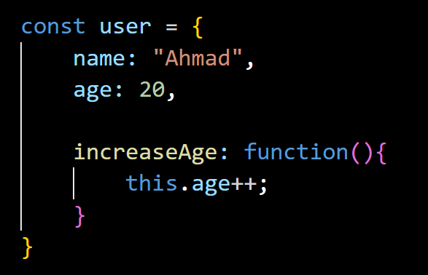

Slide 21
Primitives are Immutable
They can’t be changed

Slide 22
Memory
_

Slide 23
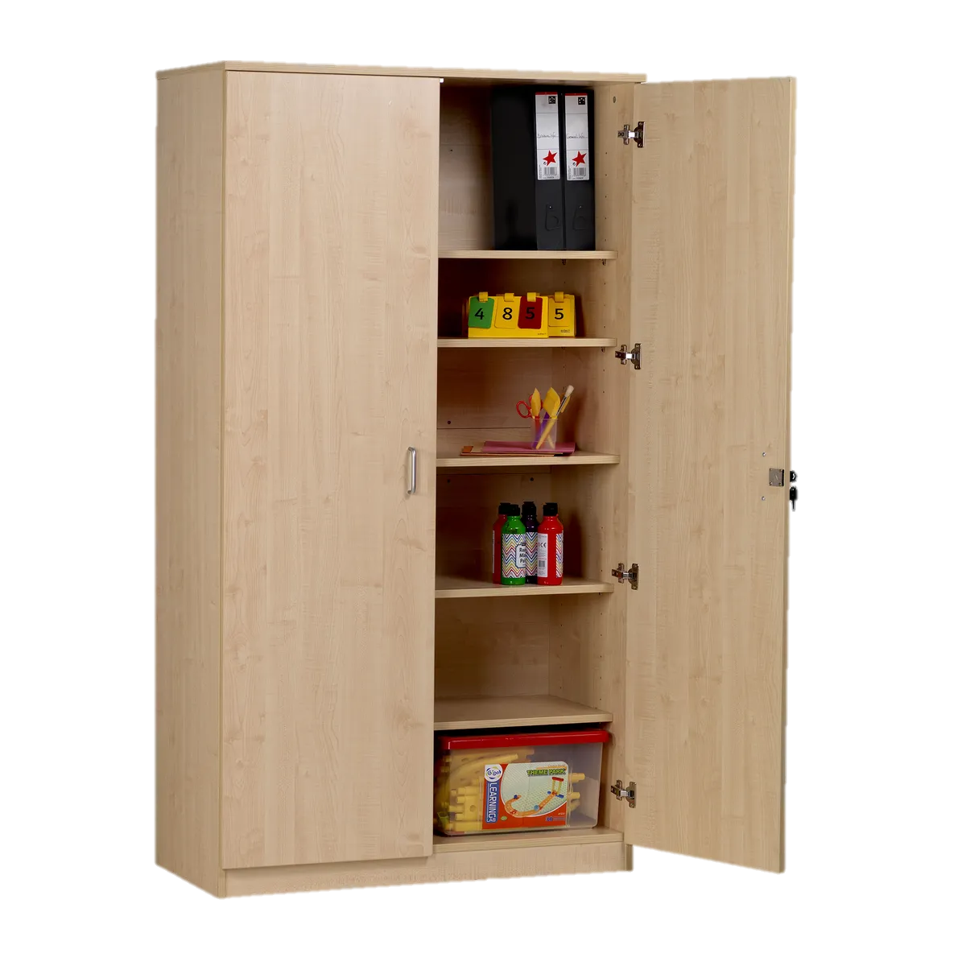

Slide 24
Notes:
- Browser gives memory for each tab

Slide 26
Stack
Heap

Slide 27
Stack
Heap
Identifier | Reference

Slide 28
Stack
Heap
Identifier | Reference
0 | 1 | 2 | 3 | 4 | 5 | 6 | 7
1
2
3
4
5
6
7

Slide 29
By Value

Slide 30


Slide 31
Stack
Heap
Identifier | Reference
0 | 1 | 2 | 3 | 4 | 5 | 6 | 7
1
2
3 |  | 20
4
5
6
7

Slide 32
Stack
Heap
Identifier | Reference
x
0 | 1 | 2 | 3 | 4 | 5 | 6 | 7
1
2
3 |  | 20
4
5
6
7

Slide 33
Stack
Heap
Identifier | Reference
x | 3x2
0 | 1 | 2 | 3 | 4 | 5 | 6 | 7
1
2
3 |  | 20
4
5
6
7

Slide 34


Slide 35
Stack
Heap
Identifier | Reference
x | 3x2
0 | 1 | 2 | 3 | 4 | 5 | 6 | 7
1
2
3 |  | 20
4
5
6
7

Slide 36
Stack
Heap
Identifier | Reference
x | 3x2
0 | 1 | 2 | 3 | 4 | 5 | 6 | 7
1
2
3 |  | 20
4
5 |  |  |  | 21
6
7

Slide 37
Stack
Heap
Identifier | Reference
x | 5x4
0 | 1 | 2 | 3 | 4 | 5 | 6 | 7
1
2
3 |  | 20
4
5 |  |  |  | 21
6
7

Slide 38
Stack
Heap
Identifier | Reference
x | 5x4
0 | 1 | 2 | 3 | 4 | 5 | 6 | 7
1
2
3
4
5 |  |  |  | 21
6
7
Notes:
- Garbage collector

Slide 39
By Reference

Slide 40
Stack
Heap
Identifier | Reference
0 | 1 | 2 | 3 | 4 | 5 | 6 | 7
1
2
3
4
5
6
7

Slide 41
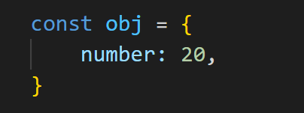

Slide 42
Stack
Heap
Identifier | Reference
obj | 2x2
0 | 1 | 2 | 3 | 4 | 5 | 6 | 7
1
2 |  | object
3
4
5
6
7

Slide 43
Stack
Heap
Identifier | Reference
obj | 2x2
0 | 1 | 2 | 3 | 4 | 5 | 6 | 7
1
2 |  | object | number
3
4
5
6
7

Slide 45
Stack
Heap
Identifier | Reference
obj | 2x2
0 | 1 | 2 | 3 | 4 | 5 | 6 | 7
1
2 |  | object | number
3
4
5 |  |  |  |  |  | 20
6
7

Slide 46
Stack
Heap
Identifier | Reference
obj | 2x2
0 | 1 | 2 | 3 | 4 | 5 | 6 | 7
1
2 |  | object | number | 5x6
3
4
5 |  |  |  |  |  | 20
6
7

Slide 47


Slide 48
Stack
Heap
Identifier | Reference
obj | 2x2
0 | 1 | 2 | 3 | 4 | 5 | 6 | 7
1
2 |  | object | number | 5x6
3
4
5 |  |  |  |  |  | 20
6
7

Slide 49


Slide 50
Stack
Heap
Identifier | Reference
obj | 2x2
0 | 1 | 2 | 3 | 4 | 5 | 6 | 7
1
2 |  | object | number | 5x6
3
4
5 |  |  |  |  |  | 20
6
7

Slide 51
Stack
Heap
Identifier | Reference
obj | 2x2
0 | 1 | 2 | 3 | 4 | 5 | 6 | 7
1
2 |  | object | number | 5x6
3
4
5 |  |  |  |  |  | 20
6 | 21
7

Slide 52
Stack
Heap
Identifier | Reference
obj | 2x2
0 | 1 | 2 | 3 | 4 | 5 | 6 | 7
1
2 |  | object | number | 6x1
3
4
5 |  |  |  |  |  | 20
6 | 21
7

Slide 53
Stack
Heap
Identifier | Reference
obj | 2x2
0 | 1 | 2 | 3 | 4 | 5 | 6 | 7
1
2 |  | object | number | 6x1
3
4
5
6 | 21
7

Slide 54
It was Oversimplified

Slide 55
null
Object | toString()
 | valueOf()
greetingProttype | greet()
Student | name
 | year

Slide 56
Assignments | 50%
Quizzes | 10%
Test | 20%
Final Project | 20%

